Slide 1
Vocabulary 3

Slide 2
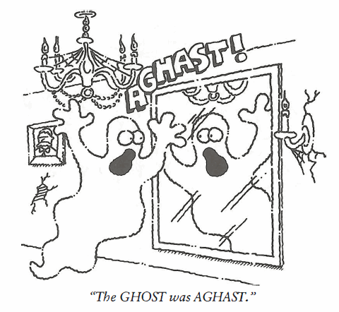
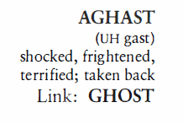
Aghast (Adj)
Evelyn was beside herself, absolutely AGHAST she wasn’t invited to the Twinklers’ tea party.

Slide 3
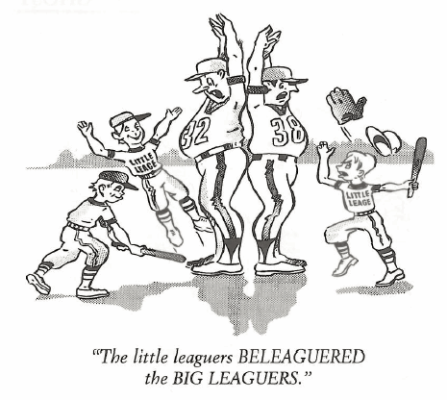
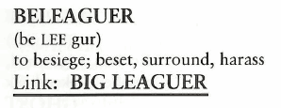
Beleaguer (V)
During his last year in office, Richard Nixon was a BELEAGUERED president, struggling to fight off the Watergate scandal.

Slide 4
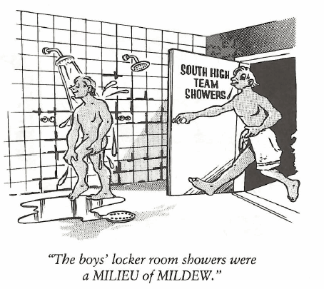
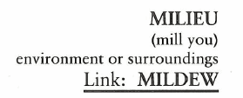
Milieu (N)
The New York Stock Exchange is a MILIEU of frenzied activity during trading hours.

Slide 5
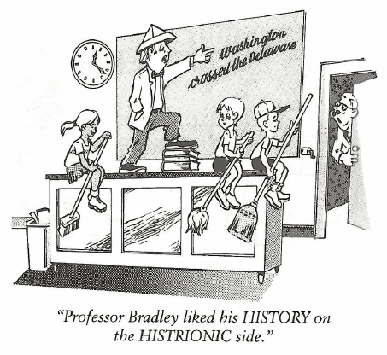
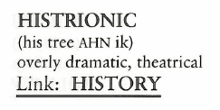
Histrionic (Adj, N)
Everything Michael said was on the swaggering, HISTRIONIC side, as if he were the coolest boy in school.

Slide 6
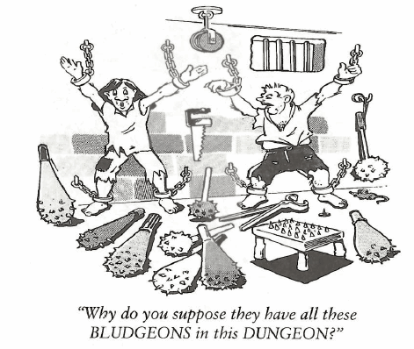
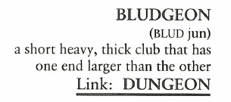
Bludgeon (N, V)
The police arrested the lumberjack on suspicion of BLUDGEONING a co-worker with an ax handle.

Slide 7
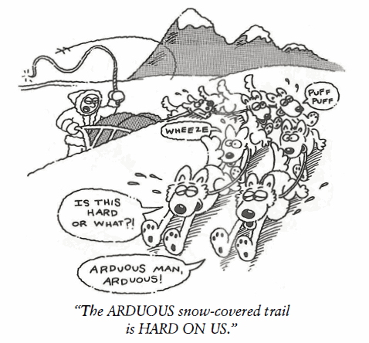
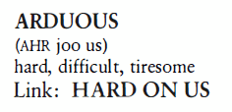
Arduous (Adj)
The assignment given the recruits was ARDUOUS—twenty miles with full packs in the hot sun.

Slide 8
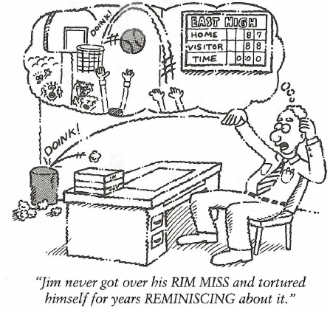
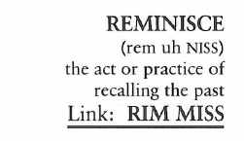
Reminisce (V)
When I am feeling nostalgic, I lie back and listen to the music of the 1970s and REMINISCE about my youth.

Slide 9
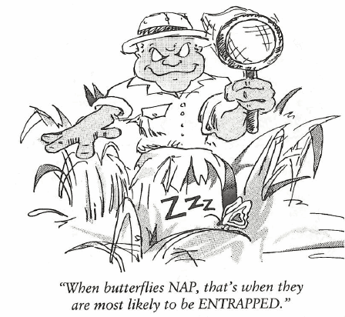
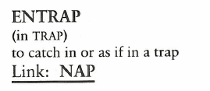
Entrap (V)
George was ENTRAPPED by a scheme which cost him his bank account and his home as well.

Slide 10
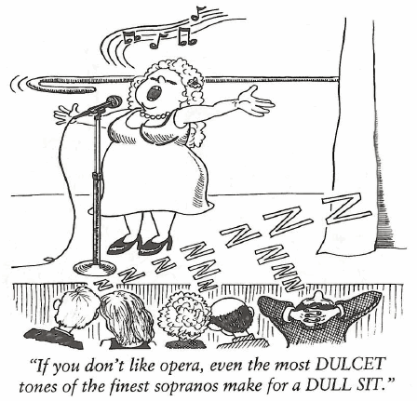
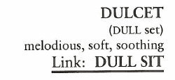
Dulcet (Adj)
Senator Kramer was a political campaigner who could hypnotize an audience with sweet words and DULCET tones.

Slide 11
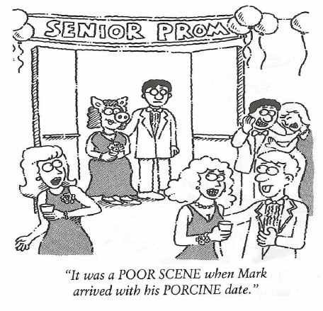
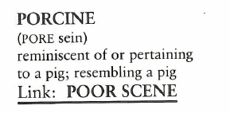
Porcine (Adj)
After an around the world cruise, where each meal is a grand feast, Bob and Helen returned home with PORCINE figures.

