Slide 1
Vocabulary 28

Slide 2
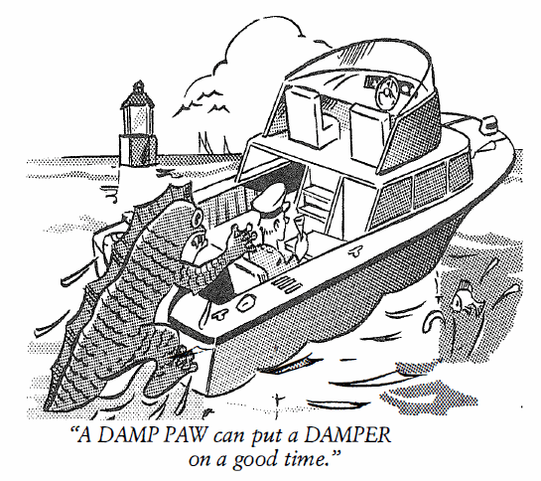
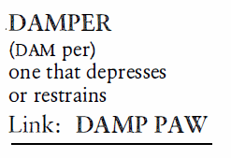
Damper (N)
The family was excited about their vacation until their father put a DAMPER on their plans, saying he was sorry, but there was no money for a vacation this year.

Slide 3
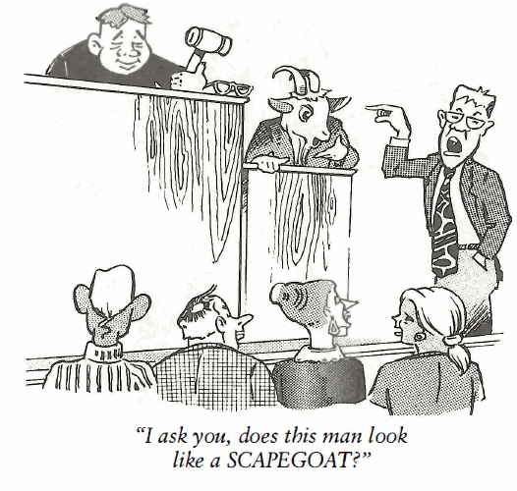
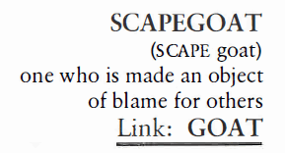
Scapegoat (N, V)
Henry was always the SCAPEGOAT, taking blame for whatever happened, whether he was to blame or not.

Slide 4
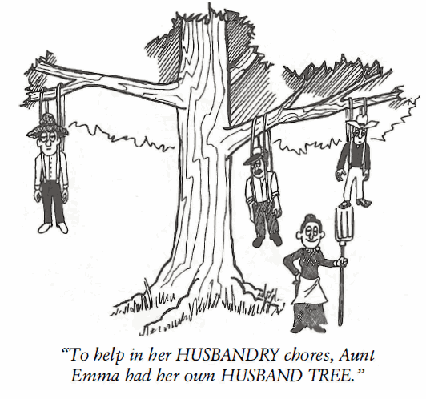
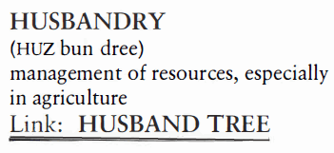
Husbandry (N)
Experts say the world’s oil resources will soon be exhausted, and we must soon begin to HUSBAND oil. (HUSBANDRY is the practice of conserving and HUSBAND is to economize.)

Slide 5
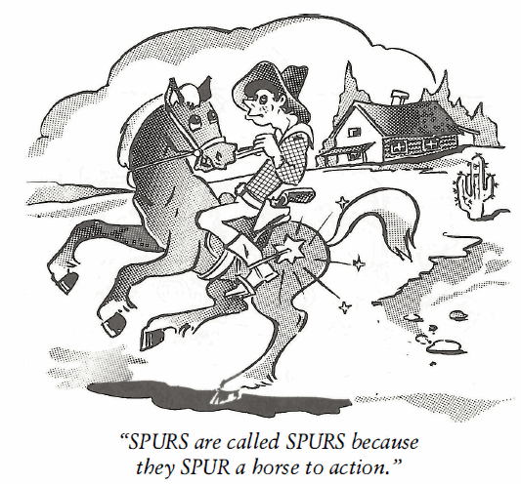
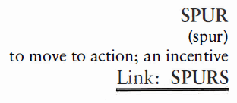
Spur (V)
In one last effort to take Snob Hill, the general SPURRED his troops by yelling, “Onward and upward, men!”

Slide 6
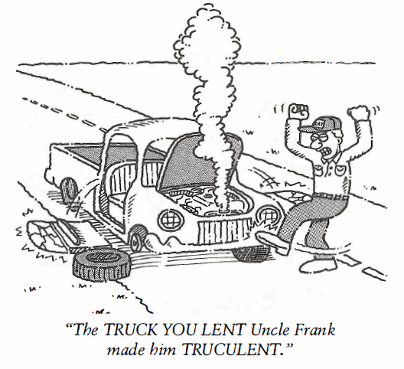
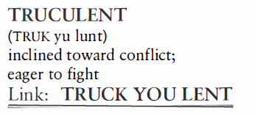
Truculent (Adj)
A TRUCULENT attitude seldom wins friends or influences people in a positive way when you argue about every point made.

Slide 7
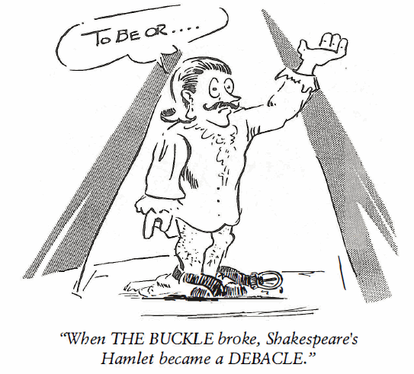
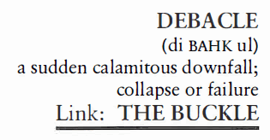
Debacle (N)
The bank went broke as a result of a DEBACLE created by the thieving board of directors.

Slide 8
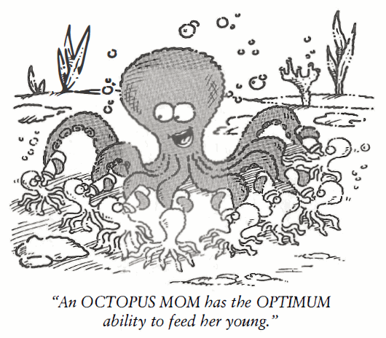
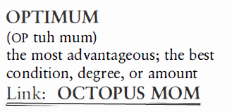
Optimum (Adj)
As the conditions were OPTIMUM, with no wind at the track, the U.S. Olympic team had hopes of breaking the world record in the 440 yard relay.

Slide 9
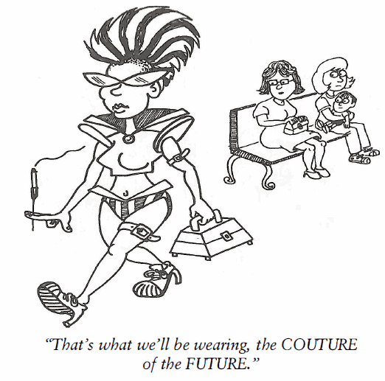
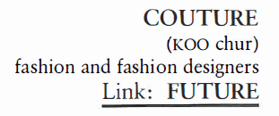
Couture (N)
COUTURE, pewture, I’ll wear what I please and those Frenchie guys can go fiddle-faddle all they want.

Slide 10
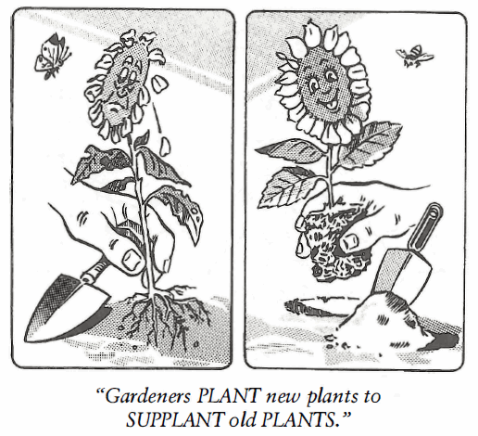
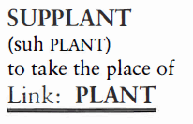
Supplant (V)
The Recreation and Parks Department’s proposed budget for next year was quickly SUPPLANTED by a budget mandated by the Board of County Commissioners.

Slide 11
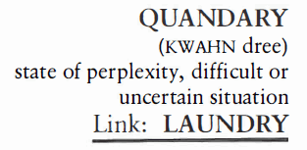
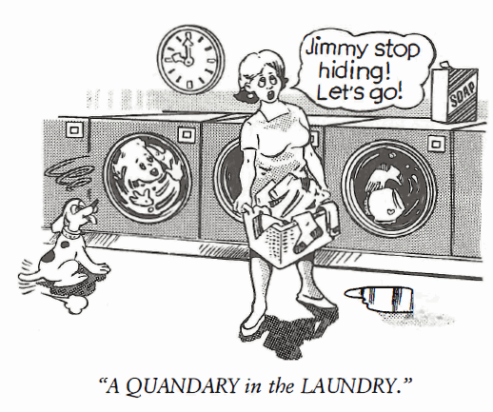
Quandary (N)
When a girl likes two boys equally well and they each ask her for a date at the same time, that is a teenage QUANDARY of major proportions.

